Slide 1
Memory Short Spec要解决的问题
产品间PSREF Spec创作逻辑差异较大
  Soldered, slots, Soldered + slots, 多种type的Soldered
PSREF Spec 的信息量无法覆盖 Short Spec
  Memory Type 与Max Memory彼此独立, 没有对应关系
降速Note缺失问题
有些问题同时存在

Slide 2
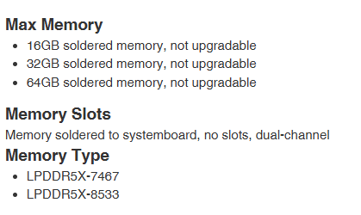
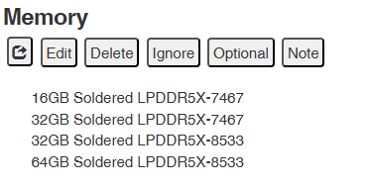
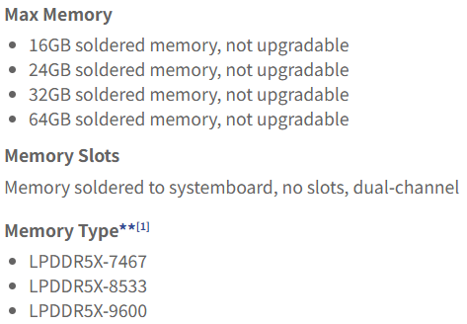
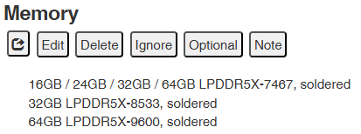

Slide 3
解题思路
拆分为三种情况
  纯soldered
    输出为Max Memory with max memory speed
    输出为Max Memory + max memory speed (取值来自Memory Type)
  纯slots
    输出为Slots + Max Memory
  Slots + soldered
    输出为
      Max Memory + Memory Type
      Slots + Max Memory

Slide 4
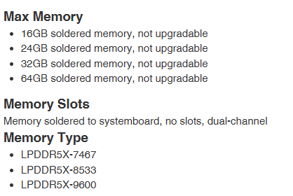
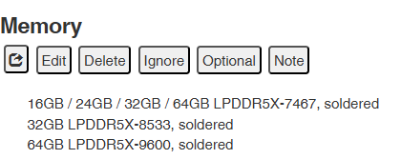
多种type的Soldered
Max Memory 没写速度, Memory Speed作为独立项目输出:
Up to 64GB soldered memory, not upgradable
Memory native speed up to LPDDR5X-9600
Max Memory 写速度了, Memory Speed不再作为独立项目输出:
Up to 64GB LPDDR5X-9600 soldered memory, not upgradable
最后输出Note, 作为提醒
Note: Installed memory is 16GB LPDDR5X-8533, 32GB LPDDR5X-8533 or 64GB LPDDR5X-9600 but may runs at lower frequency due to platform limitation.

Slide 5
Soldered + Slots
Up to 64GB soldered memory, not upgradable
Memory native speed up to LPDDR5X-9600
Note Installed memory is 16GB LPDDR5X-8533, 32GB LPDDR5X-8533 or 64GB LPDDR5X-9600 but may runs at lower frequency dueto platform limitation.

